Slide 1
Narrative
The 2nd draft: filling gaps

Slide 2
The 2nd draft

Slide 3
9 Principles of Better Stories (Connell-Waite)
Transformational
Capture attention
Tell the truth
Have measurable outcomes
Emotional
Use strong verbs and short sentences
Are surprising
Understandable
Inspire action

Slide 4
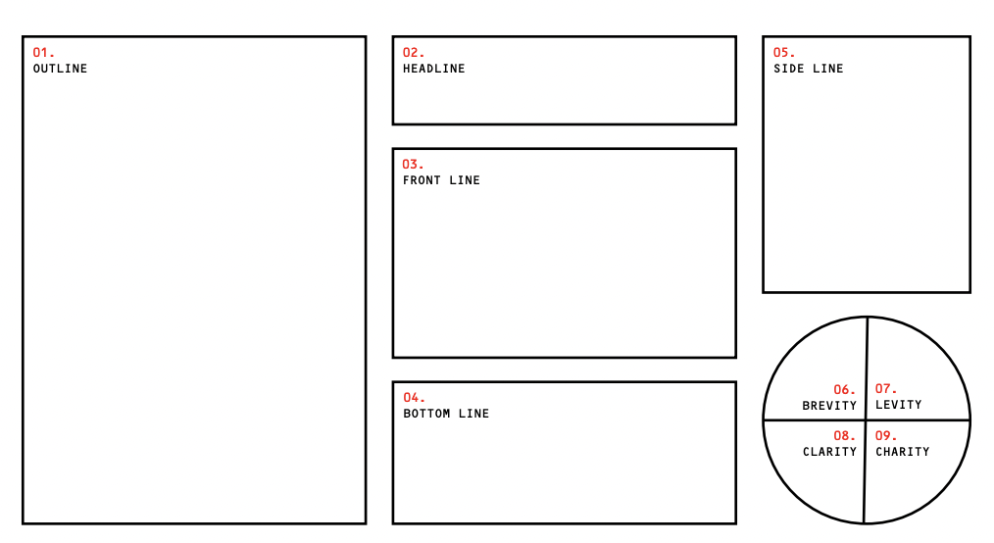
Printable version

Slide 5
User needs (try this tool)
“A plethora of specific user needs have been identified to date — from “make me feel nostalgic” and “show me how your investigation works” to “introduce authors at the top of their game” to “take me behind the scenes.””
Shishkin 2023

